Slide 1
Weekly Meeting
CCI
20 Aug 2024

Slide 2
Progress Summary
Adding Cl to ST 111 with low coverage
Adding Cl to Cuterm 100 with low coverage
Next steps, SusMoST to produce samples of varying coverage
- Chose same width approx. where the surface energy reached convergence with ST
- Tried a variety of positions, due to time, going to focus on two bridge sites

Slide 3
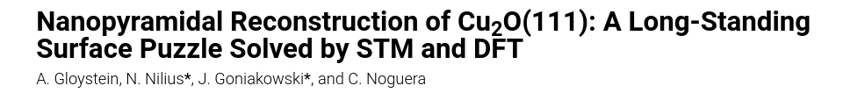
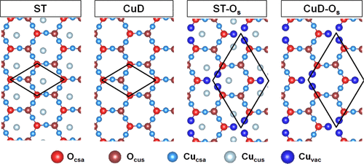
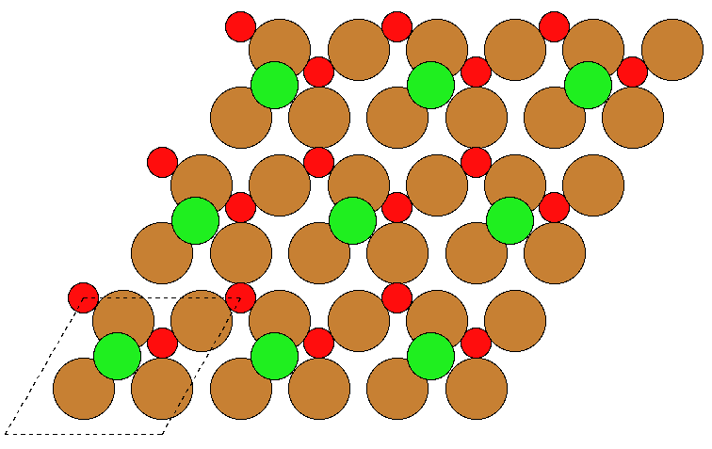
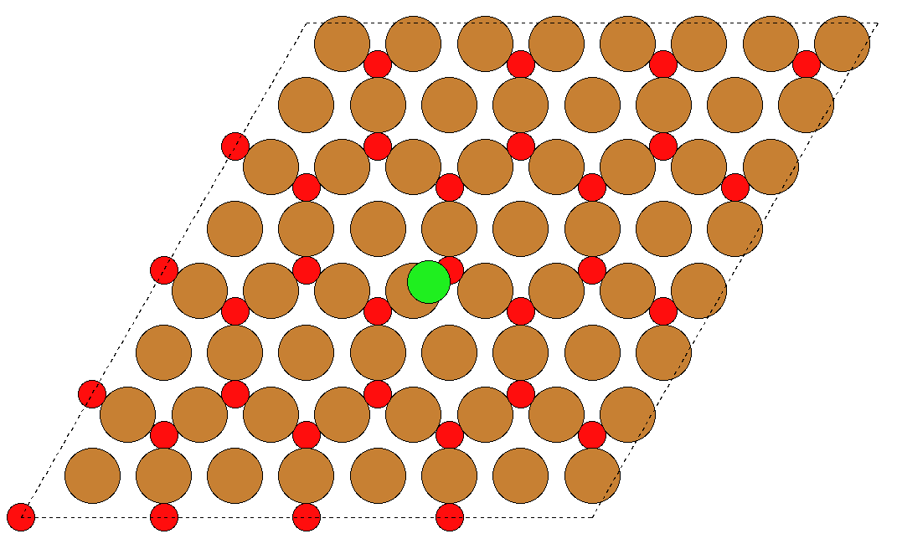

DFT with 111 Surfaces – STCl, CuO Bridge
Low coverage with 4x4 supercell

Slide 4
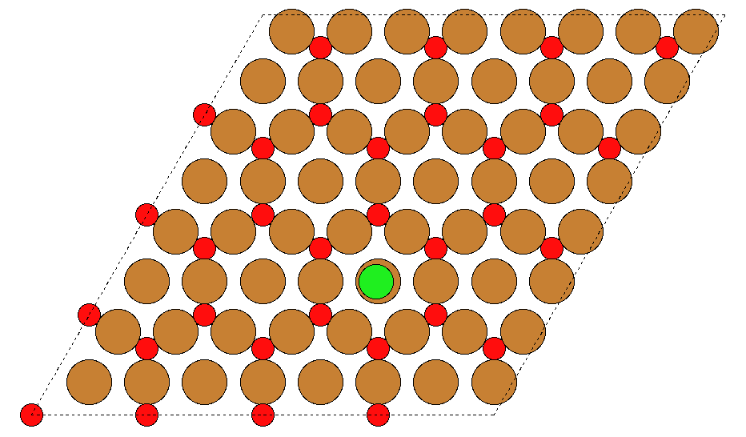
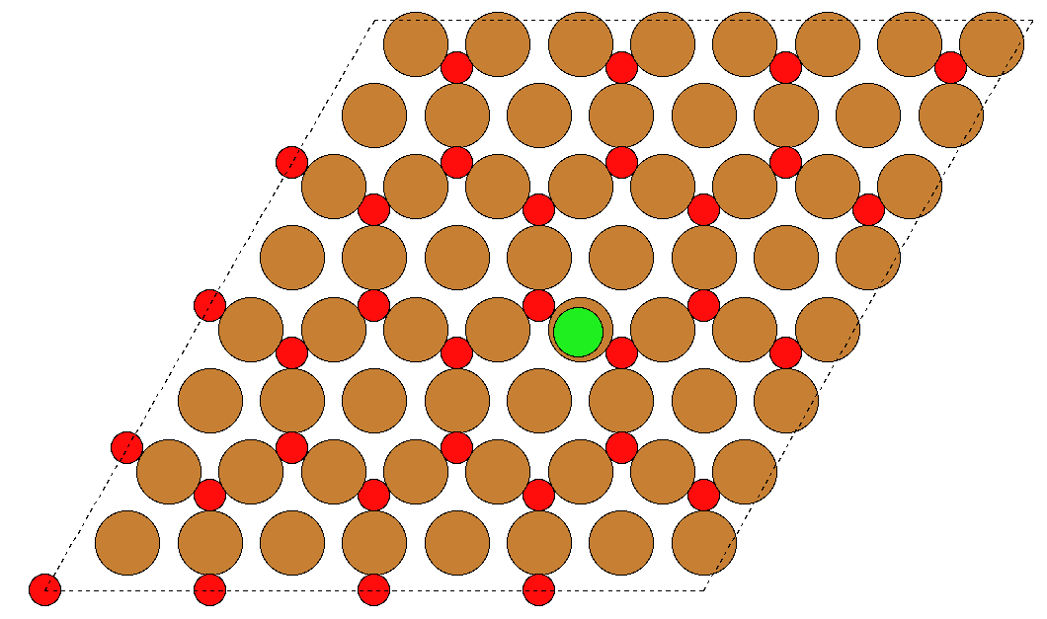
DFT with 111 Surfaces – STCl different positions

Slide 5
DFT with 111 Surfaces – STCl, CuO Bridge

Slide 6
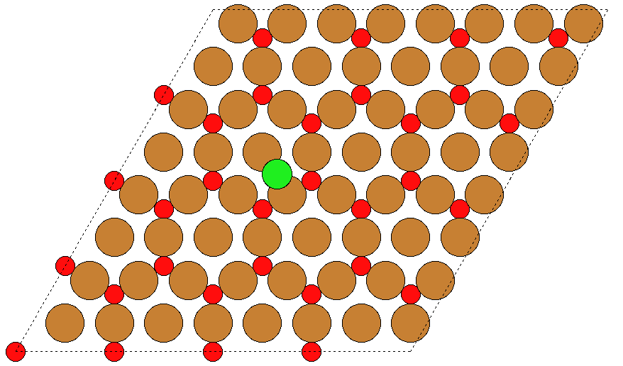
DFT with 111 Surfaces – STCl, CuCu Bridge

Slide 7
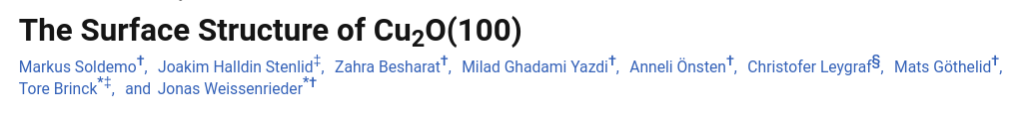
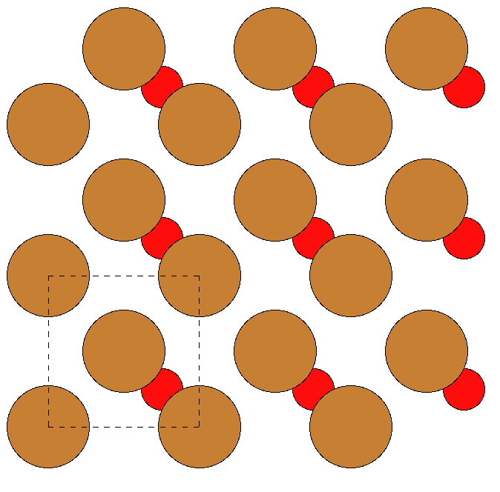
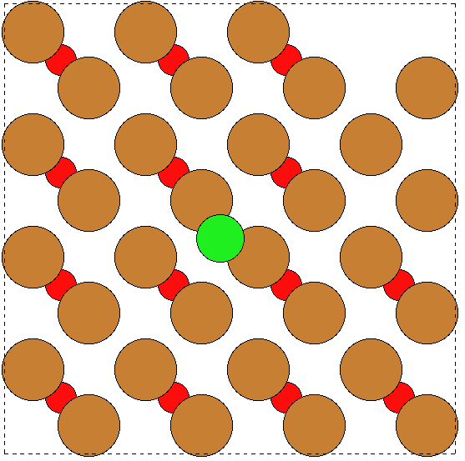
DFT with 100 Surfaces – STCl, CuCu Bridge

